Slide 1

Chapter 2
Network Models
2.<number>
Copyright © The McGraw-Hill Companies, Inc. Permission required for reproduction or display.

Slide 2
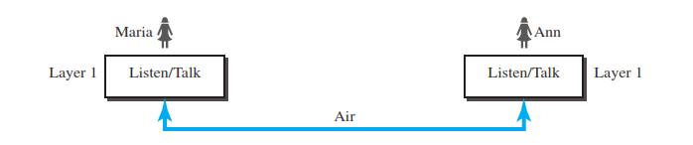
Protocol Layering
When communication is simple, we may need only one simple protocol.
When communication is complex, we may need to divide the task between different layers, in which case we need a protocol at each layer, or protocol layering.
2.<number>

Slide 3
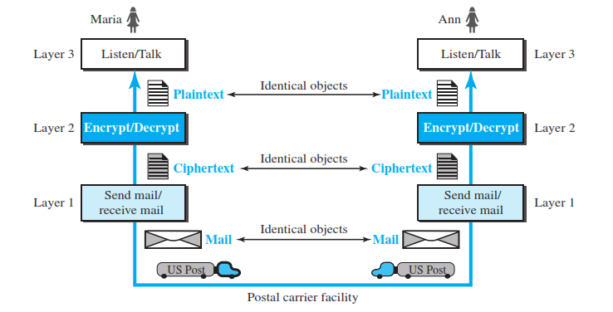
Protocol Layering
2.<number>

Slide 4
2-1 LAYERED TASKS
We use the concept of layers in our daily life. As an example, let us consider two friends who communicate through postal mail. The process of sending a letter to a friend would be complex if there were no services available from the post office.
2.<number>

Slide 5

Tasks involved in sending a letter
2.<number>

Slide 6
Principles of Protocol Layering
First Principle
It’s dictates that if we want bidirectional communication, we need to make each layer so that it is able to perform two opposite task.
Second Principle
We need to follow in protocol layering is that the two objects under each layer at both sites should be identical
2.<number>

Slide 7
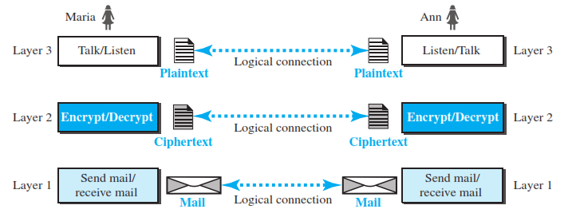
Principles of Protocol Layering
Logical connection will help us better understand the task of layering we encounter in data communication and networking.
2.<number>

Slide 8

2-2 THE OSI MODEL
Established in 1947, the International Standards Organization (ISO) is a multinational body dedicated to worldwide agreement on international standards. An ISO standard that covers all aspects of network communications is the Open Systems Interconnection (OSI) model. It was first introduced in the late 1970s.
Note
ISO is the organization.
OSI is the model.
2.<number>

Slide 9

Seven layers of OSI model
2.<number>

Slide 10

Figure 2.3 The interaction between layers in the OSI model
2.<number>

Slide 11

Figure 2.4 An exchange using the OSI model
2.<number>

Slide 12
2-3 LAYERS IN THE OSI MODEL
In this section we briefly describe the functions of each layer in the OSI model.
Physical Layer
Data Link Layer
Network Layer
Transport Layer
Session Layer
Presentation Layer
Application Layer
2.<number>

Slide 13

Physical layer
It’s coordinate function required to carry a bit stream over a physical medium.
Its also deal with and mechanical and electrical specification of interface.
Data rate - duration of a bit
Synchronization of bits - sender and receiver clock
Line configuration - P2P, MP2P, shared link
Physical topology and Transmission mode

Slide 14

Data link layer
The data link layer transform the physical layer, a raw transmission facility, to a reliable link.
It’s make the physical layer appear error – free to the upper layer ( network layer).
2.<number>

Slide 15
Data link layer
Framing: its divides the stream of bits received from the network layer into manageable data units called frame
Physical Addressing : if the frame is intended for a system outside the sender’s network, the receiver address is the address of the device that connects the network to the next one.
Flow Control: if the rate at which the data are absorbed by the receiver is less than the rate at which data are produced in the sender, this layer imposes a flow control mechanism to avoid overwhelming the receiver.
Error control : detect and retransmit damaged or lost frames. It also uses a mechanism to recognize duplicate frame
Access control : when two or more devices are connected to the same link, data link layer protocols are necessary to determine which device has control over the link at any given time.
2.<number>

Slide 16

Hop-to-hop delivery
2.<number>

Slide 17

Network layer
The network layer is responsible for the delivery of individual packets from the source host to the destination host.
Logical Addressing: if a packet passes the network boundary, we need another addressing system to help distinguish the source and destination systems.
Routing :
2.<number>

Slide 18

Source-to-destination delivery
2.<number>

Slide 19

Transport layer
It responsible for the process to process delivery of the entire message.
Recognize relationship between packets.
Service point addressing : port address
Segmentation and reassembly : each segment containing sequence number for reassemble the message correctly upon arriving at the destination and to identify and replace
Connection control :
Flow control and Error control:
2.<number>

Slide 20

Reliable process-to-process delivery of a message
2.<number>

Slide 21

Session layer
It responsible for dialog control and synchronization
Dialog control : it allow the communication between two processes to take place in either half duplex and full duplex mode
Synchronization : it’s allow a process to add checkpoints, or synchronization points, to stream of data
2.<number>

Slide 22

Presentation layer
It concern with syntax and semantics of the information exchanged between two systems
Translation : Provide interoperability between different encoding methods
Encryption/ Decryption : to carry sensitive information, a system must be able to ensure privacy.
Compression : Data compression reduces the number of bits contained in the information.
2.<number>

Slide 23

Application layer
It responsible for providing service to user.
Network virtual terminal : allow user to log on remote host.
Mail services:
Directory services : Global information about various objects and services.
2.<number>

Slide 24
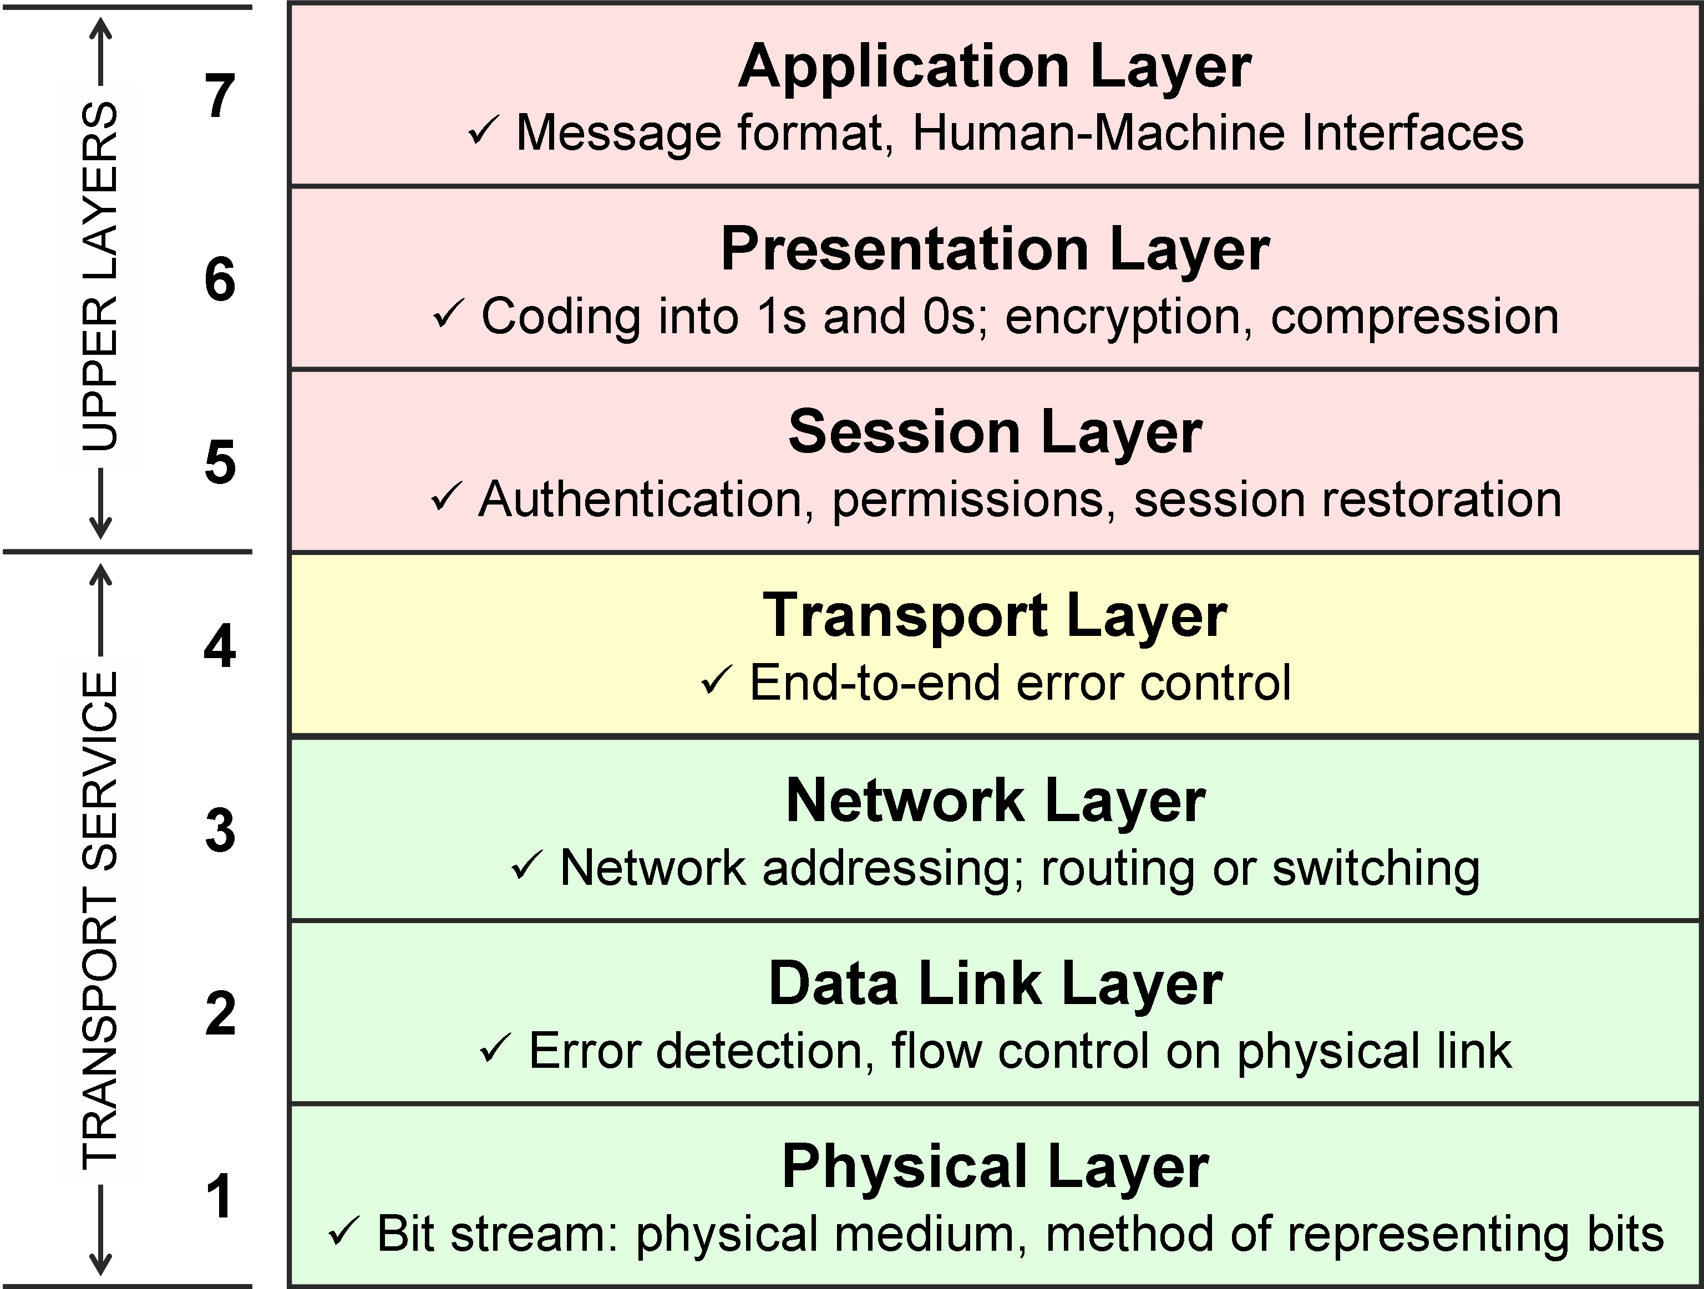
Summary of layers
2.<number>

Slide 25

Summary of layers
2.<number>

Slide 26
2-4 TCP/IP PROTOCOL SUITE
The layers in the TCP/IP protocol suite do not exactly match those in the OSI model. The original TCP/IP protocol suite was defined as having four layers: host-to-network, internet, transport, and application. However, when TCP/IP is compared to OSI, we can say that the TCP/IP protocol suite is made of five layers: physical, data link, network, transport, and application.
Physical and Data Link Layers
Network Layer
Transport Layer
Application Layer
2.<number>

Slide 27
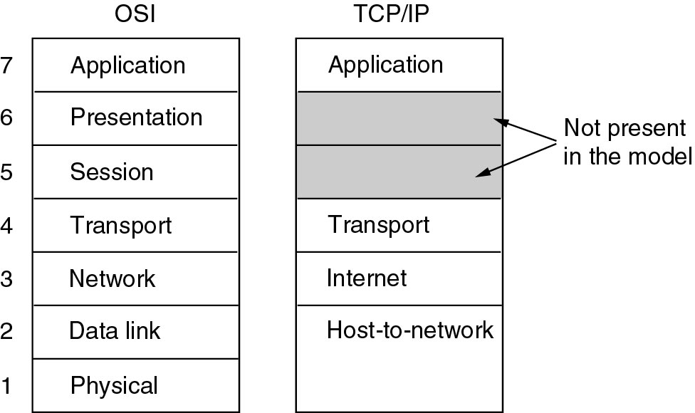
TCP/IP and OSI model
2.<number>

Slide 28

Figure 2.16 TCP/IP and OSI model
2.<number>

Slide 29
A Critique of the TCP/IP Reference Model
Problems:
Service, interface, and protocol not distinguished
Not a general model
Host-to-network “layer” not really a layer
No mention of physical and data link layers
Minor protocols deeply entrenched, hard to replace
2.<number>

Slide 30
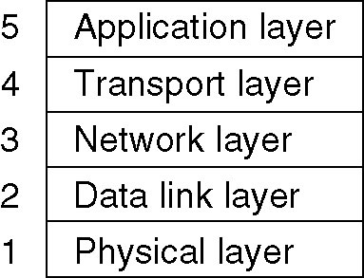
Hybrid Model
The Internet
Connection-Oriented Networks: X.25, Frame Relay, and ATM
Ethernet
Wireless LANs: 802:11
ARPANET
NSFNET
ATM
2.<number>

Slide 31
2-5 ADDRESSING
Four levels of addresses are used in an internet employing the TCP/IP protocols: physical, logical, port, and specific.
Topics discussed in this section:
Physical Addresses
Logical Addresses
Port Addresses
Specific Addresses
2.<number>

Slide 32

Figure 2.17 Addresses in TCP/IP
2.<number>

Slide 33

Figure 2.18 Relationship of layers and addresses in TCP/IP
2.<number>

Slide 34
Example 2.1
In Figure 2.19 a node with physical address 10 sends a frame to a node with physical address 87. The two nodes are connected by a link (bus topology LAN). As the figure shows, the computer with physical address 10 is the sender, and the computer with physical address 87 is the receiver.
2.<number>

Slide 35

Figure 2.19 Physical addresses
2.<number>

Slide 36
Example 2.2
Most local-area networks use a 48-bit (6-byte) physical address written as 12 hexadecimal digits; every byte (2 hexadecimal digits) is separated by a colon, as shown below:
07:01:02:01:2C:4B
A 6-byte (12 hexadecimal digits) physical address.
2.<number>

Slide 37
Example 2.3
Figure 2.20 shows a part of an internet with two routers connecting three LANs. Each device (computer or router) has a pair of addresses (logical and physical) for each connection. In this case, each computer is connected to only one link and therefore has only one pair of addresses. Each router, however, is connected to three networks (only two are shown in the figure). So each router has three pairs of addresses, one for each connection.
2.<number>

Slide 38

Figure 2.20 IP addresses
2.<number>

Slide 39
Example 2.4
Figure 2.21 shows two computers communicating via the Internet. The sending computer is running three processes at this time with port addresses a, b, and c. The receiving computer is running two processes at this time with port addresses j and k. Process a in the sending computer needs to communicate with process j in the receiving computer. Note that although physical addresses change from hop to hop, logical and port addresses remain the same from the source to destination.
2.<number>

Slide 40

Figure 2.21 Port addresses
2.<number>

Slide 41
Note
The physical addresses will change from hop to hop,
but the logical addresses usually remain the same.
2.<number>

Slide 42
Example 2.5
A port address is a 16-bit address represented by one decimal number as shown.
753
A 16-bit port address represented
as one single number.
2.<number>

Slide 43
Network Hardware
Local Area Networks
Metropolitan Area Networks
Wide Area Networks
Wireless Networks
Home Networks
Internetworks
2.<number>

Slide 44
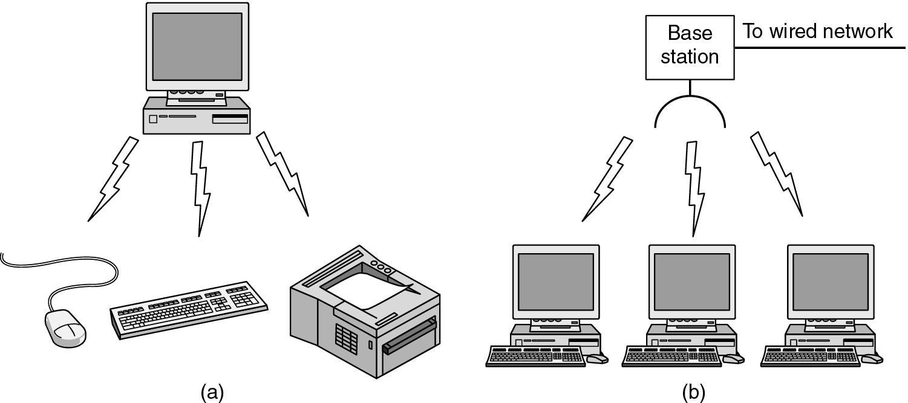
Wireless Network
2.<number>

Slide 45
Home Network
Computers (desktop PC, PDA, shared peripherals
Entertainment (TV, DVD, VCR, camera, stereo, MP3)
Telecomm (telephone, cell phone, intercom, fax)
Appliances (microwave, fridge, clock, furnace, airco)
Telemetry (utility meter, burglar alarm, babycam)
2.<number>

Slide 46
Network Software
Protocol Hierarchies
Design Issues for the Layers
Connection-Oriented and Connectionless Services
Service Primitives
The Relationship of Services to Protocols
2.<number>

Slide 47
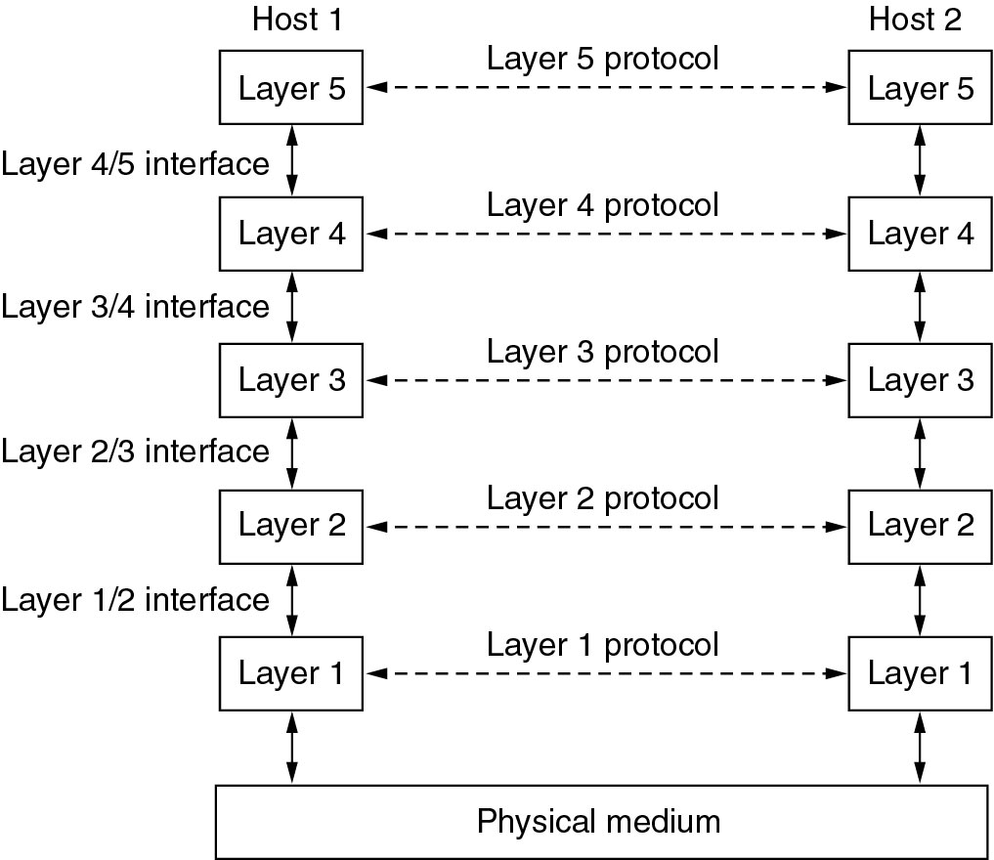
Network Software
Protocol Hierarchies
2.<number>

Slide 48
Network Software
Design Issues for the Layers
Addressing
Error Control
Flow Control
Multiplexing
Routing
2.<number>

Slide 49
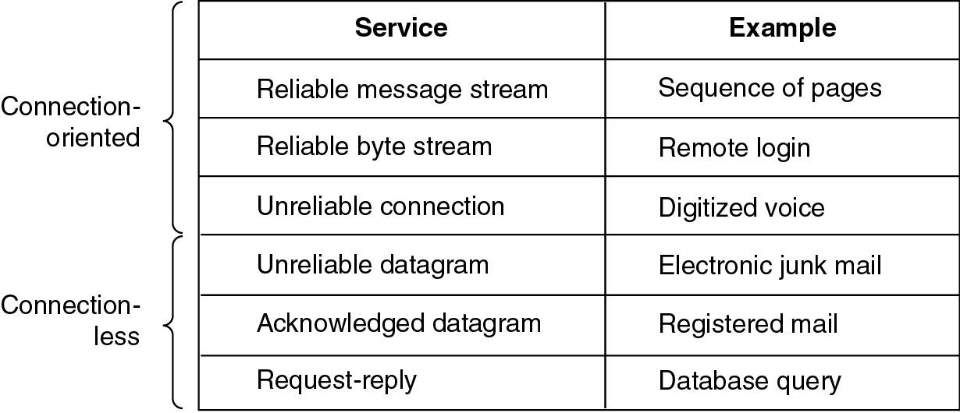
Network Software
Connection Oriented and Connection less services
2.<number>

Slide 50
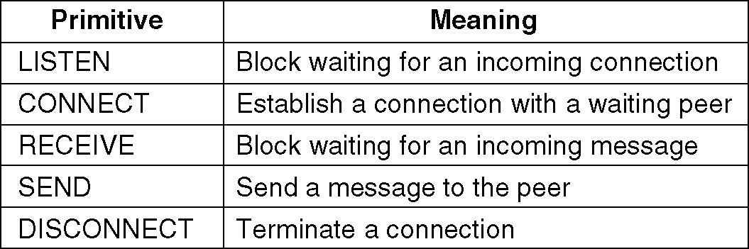
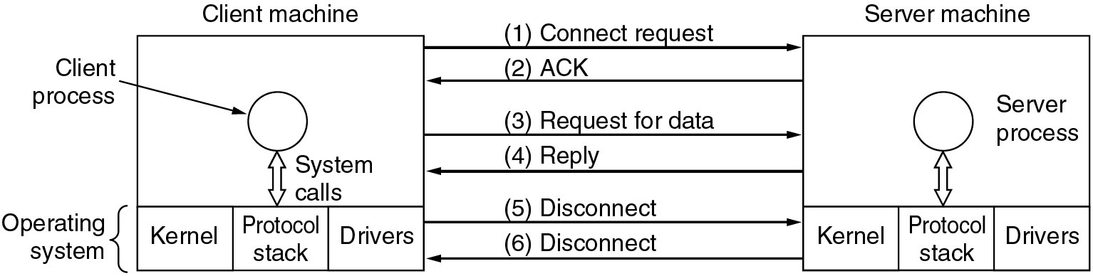
Network Software
Service Primitives (connection oriented)
2.<number>

Slide 51
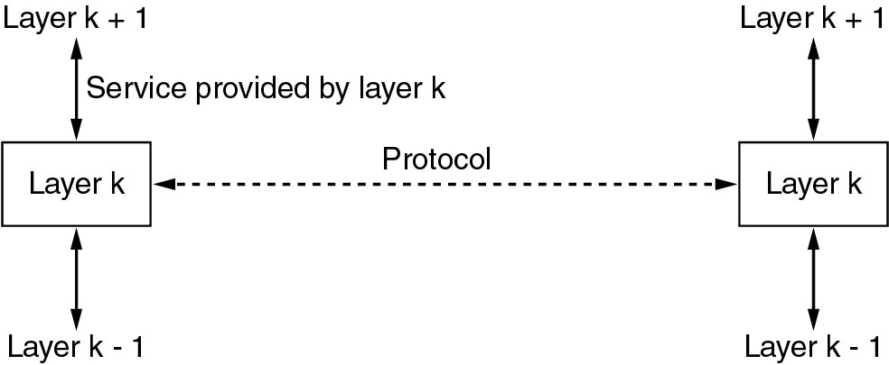
Network Software
Service to protocols relationship
2.<number>

